Slide 1
INSTALLING INTERNET INFORMATIONAL SERVICES
(20IT4607 - ETHICAL HACKING PROJECT)
MD NEELOFAR JAHA ( 208w1a1298 )
MD RIZWANULLAH ( 208w1a1299 )
M J N VENKATA SAI ( 208w1a12A0 )
N AJAY KUMAR VARMA ( 208w1a12A1 )

Slide 2
Problem Statement
Install IIS on your Windows computer. Description: To create a Web site, you need to install IIS on your Windows computer. AlthoughIIS is deployed on a server in a production environment, preproduction Web development andtesting are typically done on workstations. IIS 5.1 is available in Windows XP Professional, IIS7is available in Vista (Business, Ultimate, and Enterprise editions), and IIS 7.5 is available inWindows 7 (Professional, Ultimate, and Enterprise). Because IIS isn’t installed by default, inthisactivity, you install it and use your Web browser to check that it was installed correctly

Slide 3
Introduction
The term IIS stands for Internet Information Services, which is a general-purpose webserver that runs on the Windows operating system. The IIS accepts and responds to the client's computer requests and enables them to share and deliver information across the LAN such as a corporate intranet and the WAN the internet. It hosts the application, websites, and other standard services needed by users and allows developers to make websites, applications and virtual directories to share with their users. The webservers are commonly used as a portal for sophisticated and highly interactive websites, applications that the middleware and back-end applications together to make enterprise-grade-systems.

Slide 4
Description
Modern web servers can provide far more functionality for a business and its users. Webservers are often used as portals for sophisticated, highly interactive, web-based applications that the enterprise middleware and back-end applications together to create enterprise-class systems

Slide 5
Security
To ensure a website is secure, organizations need to take security measures. Companies can use features built into IIS to harden the IIS. Some of the ways to harden Windows IIS include:
Ensure the Windows operating system is updated with all security patches.
Disable any features of IIS not in use to reduce potential attacks.
Use firewalls to ensure the server is only receiving valid packets.
Control which IP addresses and domains can access the web server.
Use URL authorization to apply rules for specific requests, such as dealing with particular URLs. A company can use URL authorization to only authorize certain users toview the requested pages.
Use logging to view the visitors accessing the web server.

Slide 6
How IIS works
IIS works through a variety of standard languages and protocols. HTML is used to create elements such as text, buttons, image placements, direct interactions/behaviors and hyperlinks. The Hypertext Transfer Protocol is the basic communication protocol used to exchange information between web servers and users.
HTTPS -- HTTP over Secure Sockets Layer (SSL) -- uses Transport layer Security or SSL to encrypt the communication for added data security. TheFile Transfer Protocol (FTP), or its secure variant, FTPS, can transfer files. Additional supported protocols include the Simple Mail Transfer Protocol (SMTP), to sendandreceive email, and the Network News Transfer Protocol, to deliver articles on USENET

Slide 7
Installing IIS in Windows
IIS or Internet Information Services is available in most editions of Windows, though disabled by default. manually. This article explains how to install IIS on a Windows 10 machine.
1.Open the Start menu.
2. Open the Control panel app

Slide 8
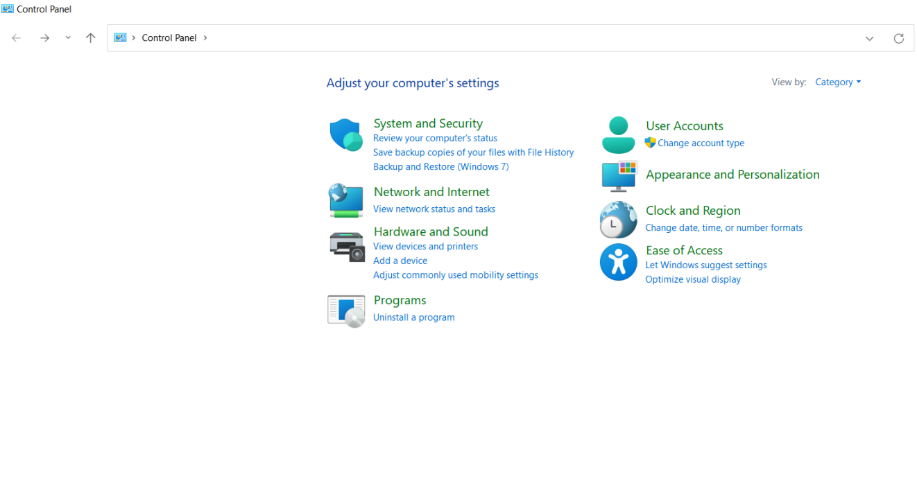

3. In Control Panel Go to :
Programs In programs and features Select Turn Windows festures on and off.

Slide 9
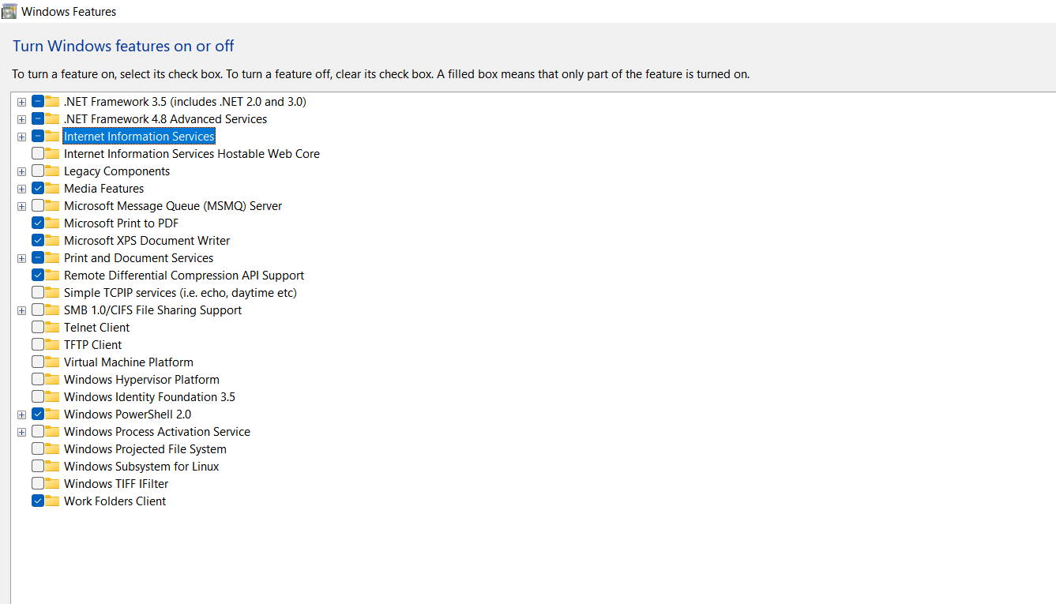
4. Then the below Window will open and Click on Internet Information Services Option and Then select Ok option ..

Slide 10
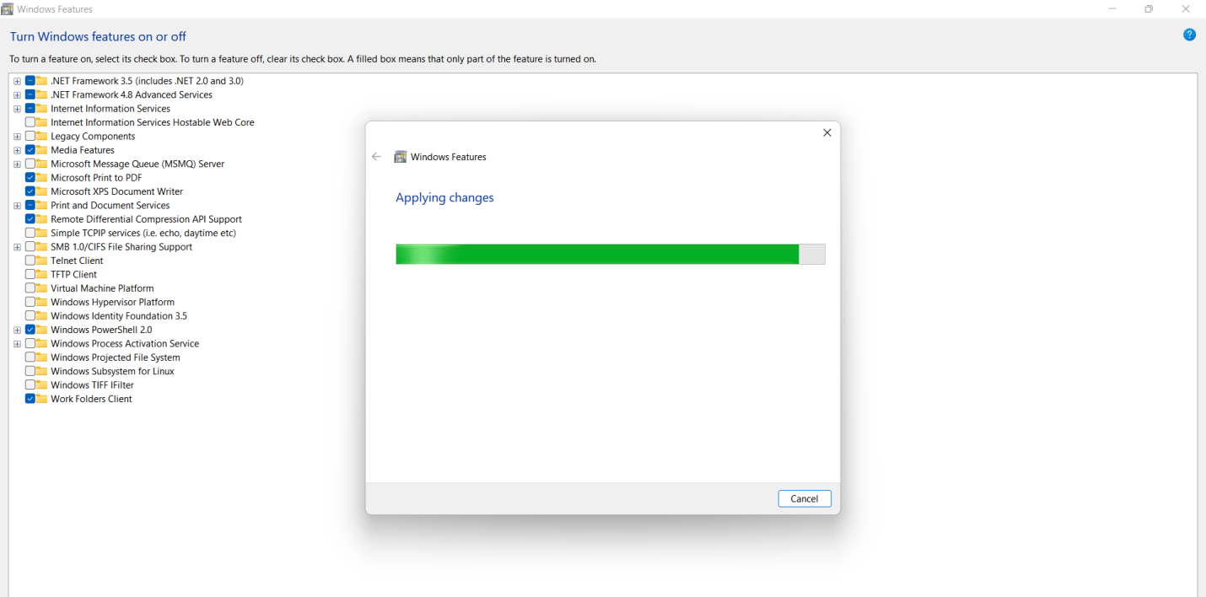
5. After selecting Ok. Just Wait for the installation to complete and hit Close.

Slide 11
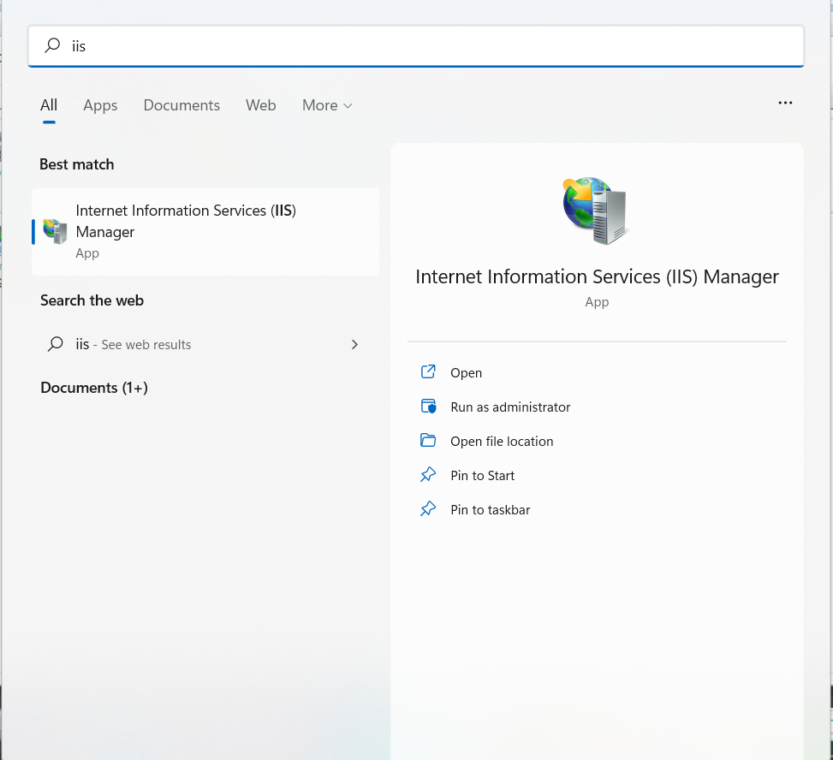
6. Our Installation is completed. After Installation Just go to Start and Search for IIS.

Slide 12
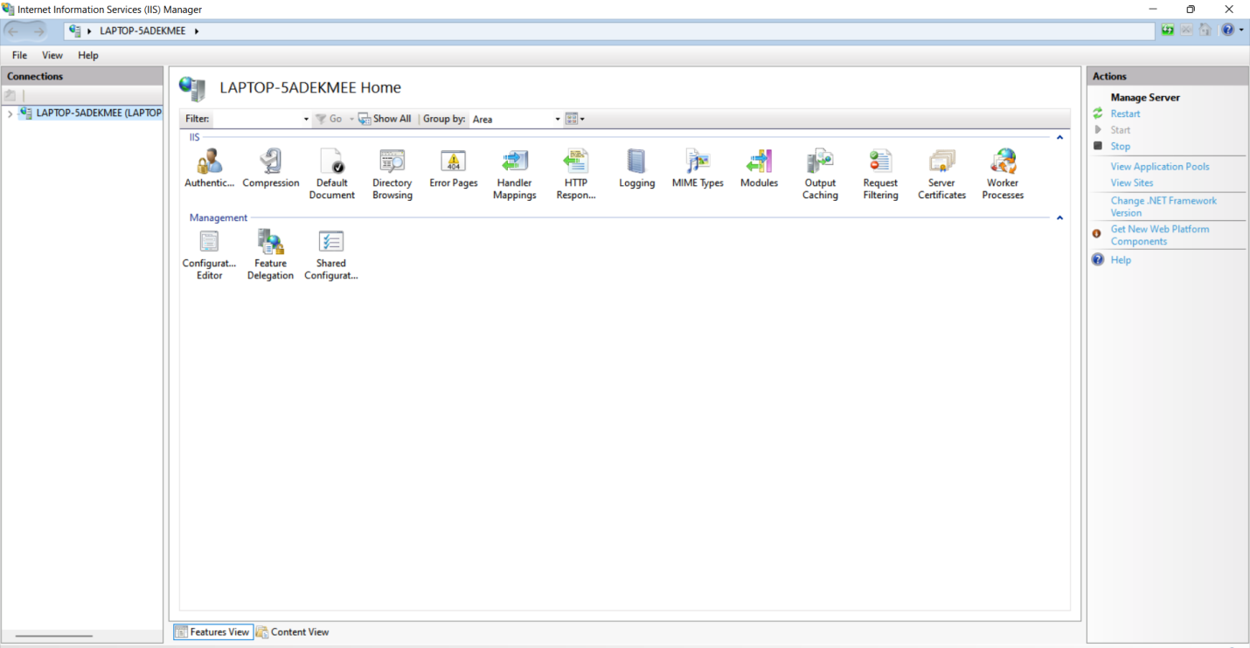
7. This is how the Internet Information Panel looks like.

Slide 13
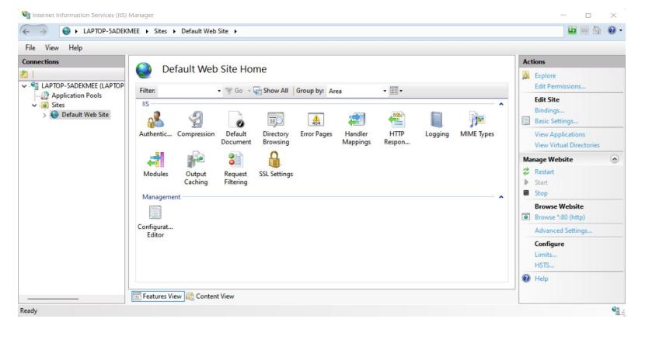
Using web browser to check that is installed correctly by taking an simple example.
Step – 1 : create a simple “welcome” webpage in html
Step – 2 : then go to the ISS and click on the start option there.

Slide 14
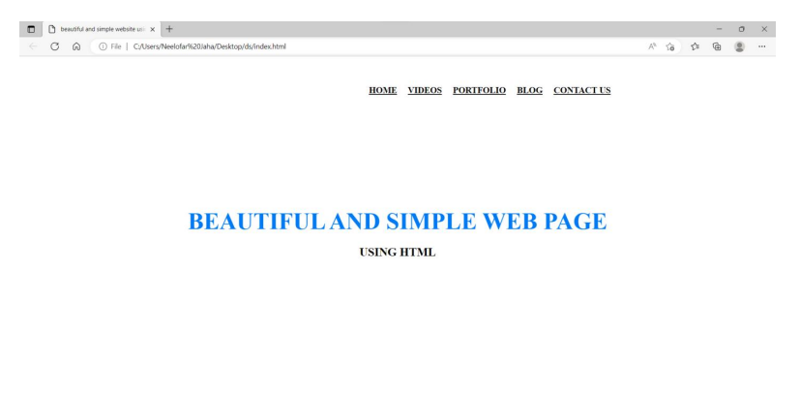
Step 3 : I have created a simple html web page and named it as a index.html in a local machine and this is index.html looks like

Slide 15
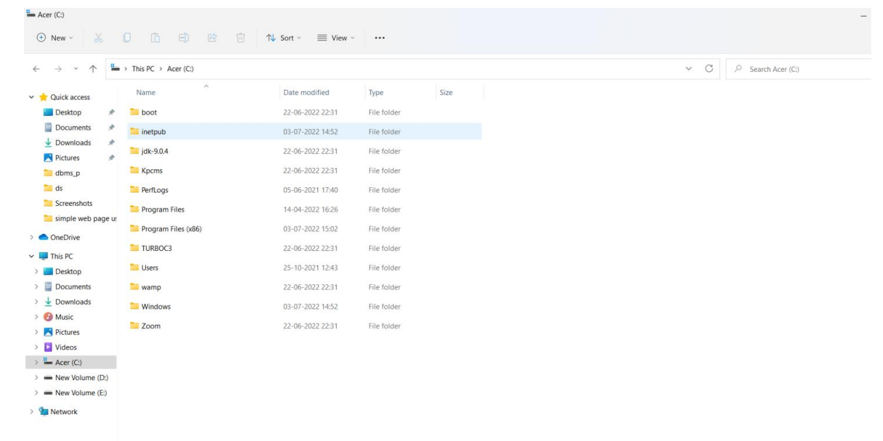
Step – 4 : Now, copy your index.html file and then navigate to the directory
C drive → then click on the option inetpub folder.

Slide 16
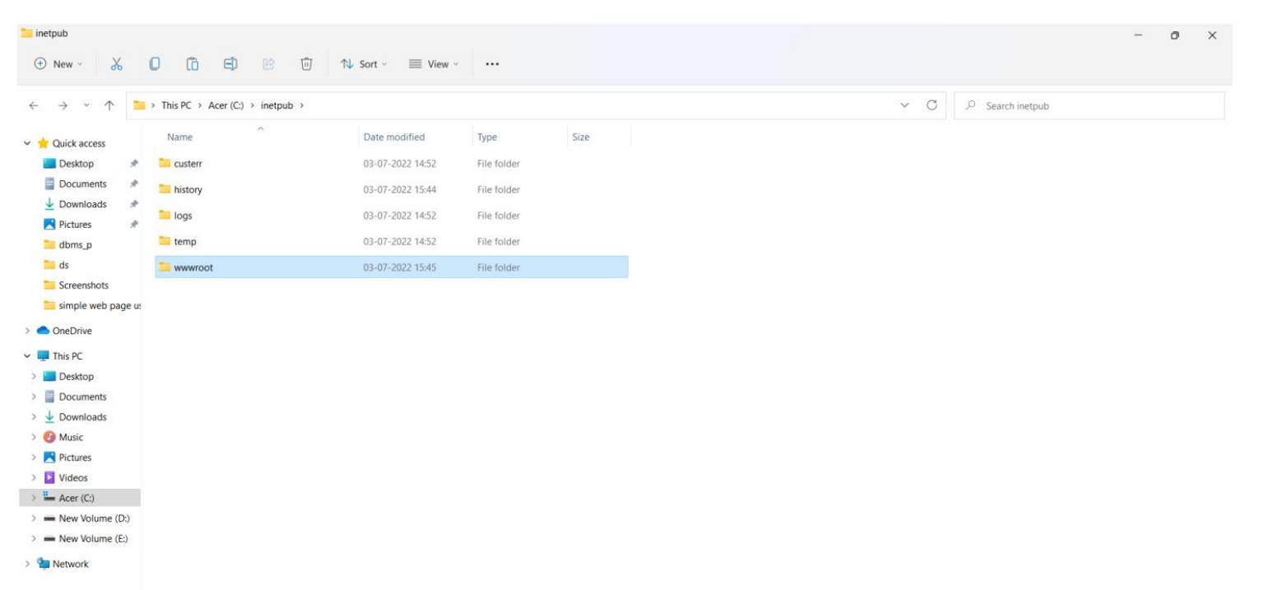
Step – 5 : After navigating to the inetpub then click on the option called wwwroot a subfolder in inetpub directory.

Slide 17
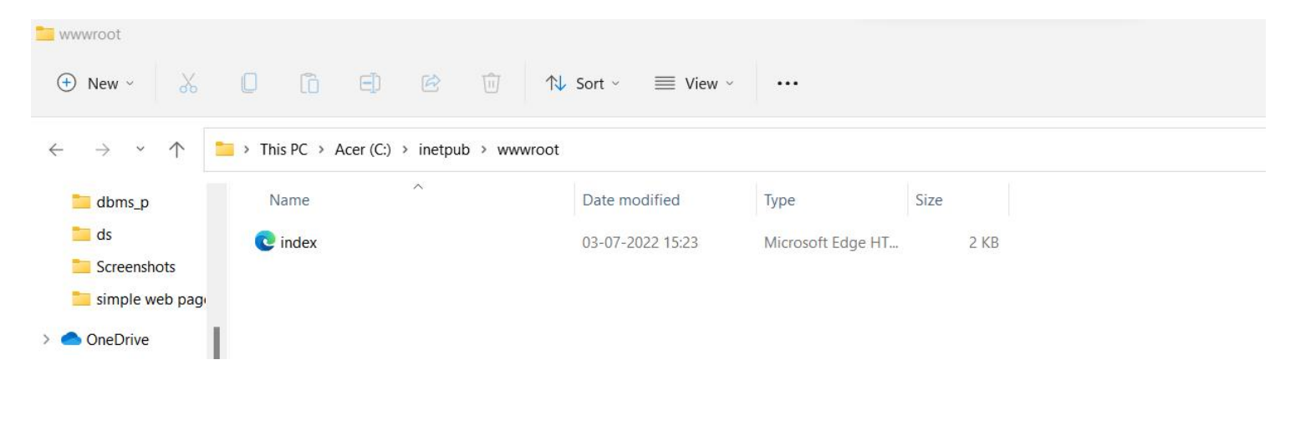
Step – 6 : inside the wwwroot folder clear all previous files and add the index.html file which you created previously.
Step – 7 : Now, again go to the information services (IIS) and click on start option

Slide 18
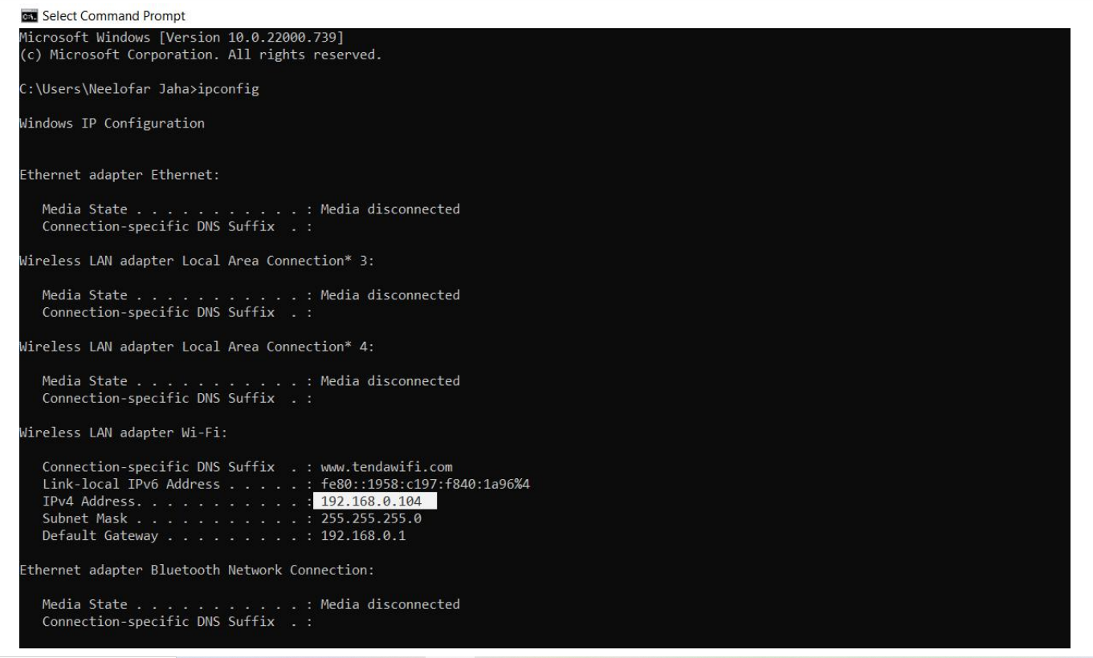
Step – 8 : Now, go to the command prompt and then get the ip address of your pc or computer.

Slide 19
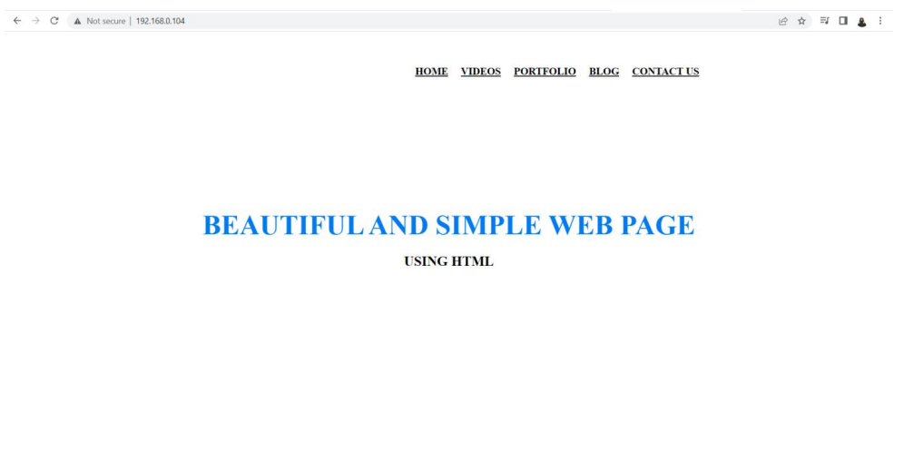
Step – 9 : Now, go to web browser and then type your’s pc ip address. Then the created webpage will be displayed on the screen.

Slide 20
Conclusion :
This guide has outlined the step-by-step process for planning an IIS 7.0 infrastructure.
By proceeding from step to step, major decisions regarding the IIS 7.0 infrastructure were relevently explained.
The guide has explained how to record choices of location, implementation method, server platform, server resources, and fault tolerance and make them available to infrastructure planners. Using the information recorded from the steps completed in this guide, the organization can effectively deploy an IIS infrastructure with assurance that it is properly planned and prepared for a successful .

Slide 21
References :
https://www.javatpoint.com/what-is-iis
https://www.youtube.com/watch?v=EsaQMkKHGfk
https://www.techtarget.com/searchwindowsserver/definition/IIS#:~:text=Internet%20Information%20Services%20(IIS)%20is,and%20returns%20the%20appropriate%20response.

Slide 22
Thank you

